Slide 1
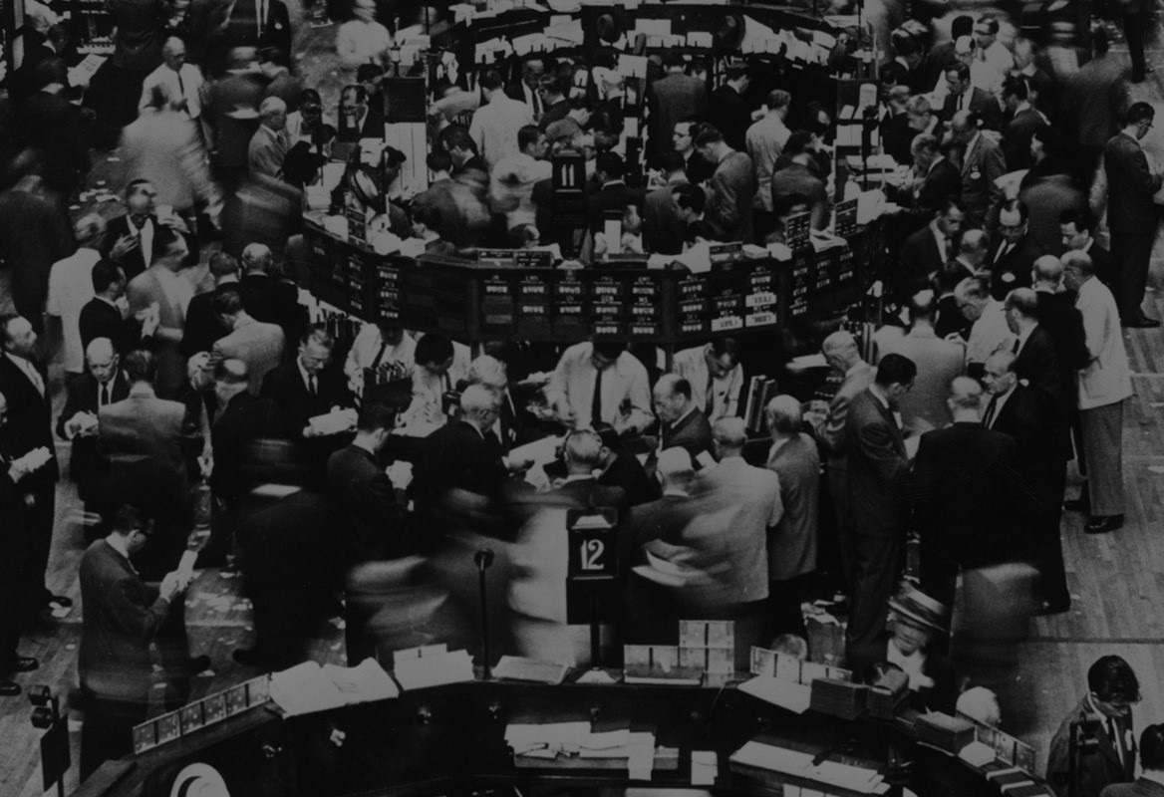
A Survey on Emergent Advanced Analytics Techniques Applicable to the Financial Services Industry
Notes:
[David]
Good evening all. My name is David, and today I’m joined by my colleagues Abhishek, Justin and Zeynep to provide a survey of emergent advanced analytics techniques that are applicable to the financial services industry. Among the rapidly evolving landscape that is data science and analytics, we think there are several areas of innovation that Acme financial would disproportionately benefit from.
We recognize that, yourselves, as a data science team, analytics, data, statistics, and modeling are already your bread and butter. Your team is already more than capable of constructing clean tabular datasets to extract invaluable insights to shape shape both strategic and operational visions within the organization. We hope that the methods we’re introducing today will enable your team to extend beyond tables and databases, and instead think about data science more from the perspective of information science.
Whether that be gathering, organizing or visualizing, using the most appropriate tools to gather and present information will enable your stakeholders to make the most informed business decisions as a result.
[1min]

Slide 2
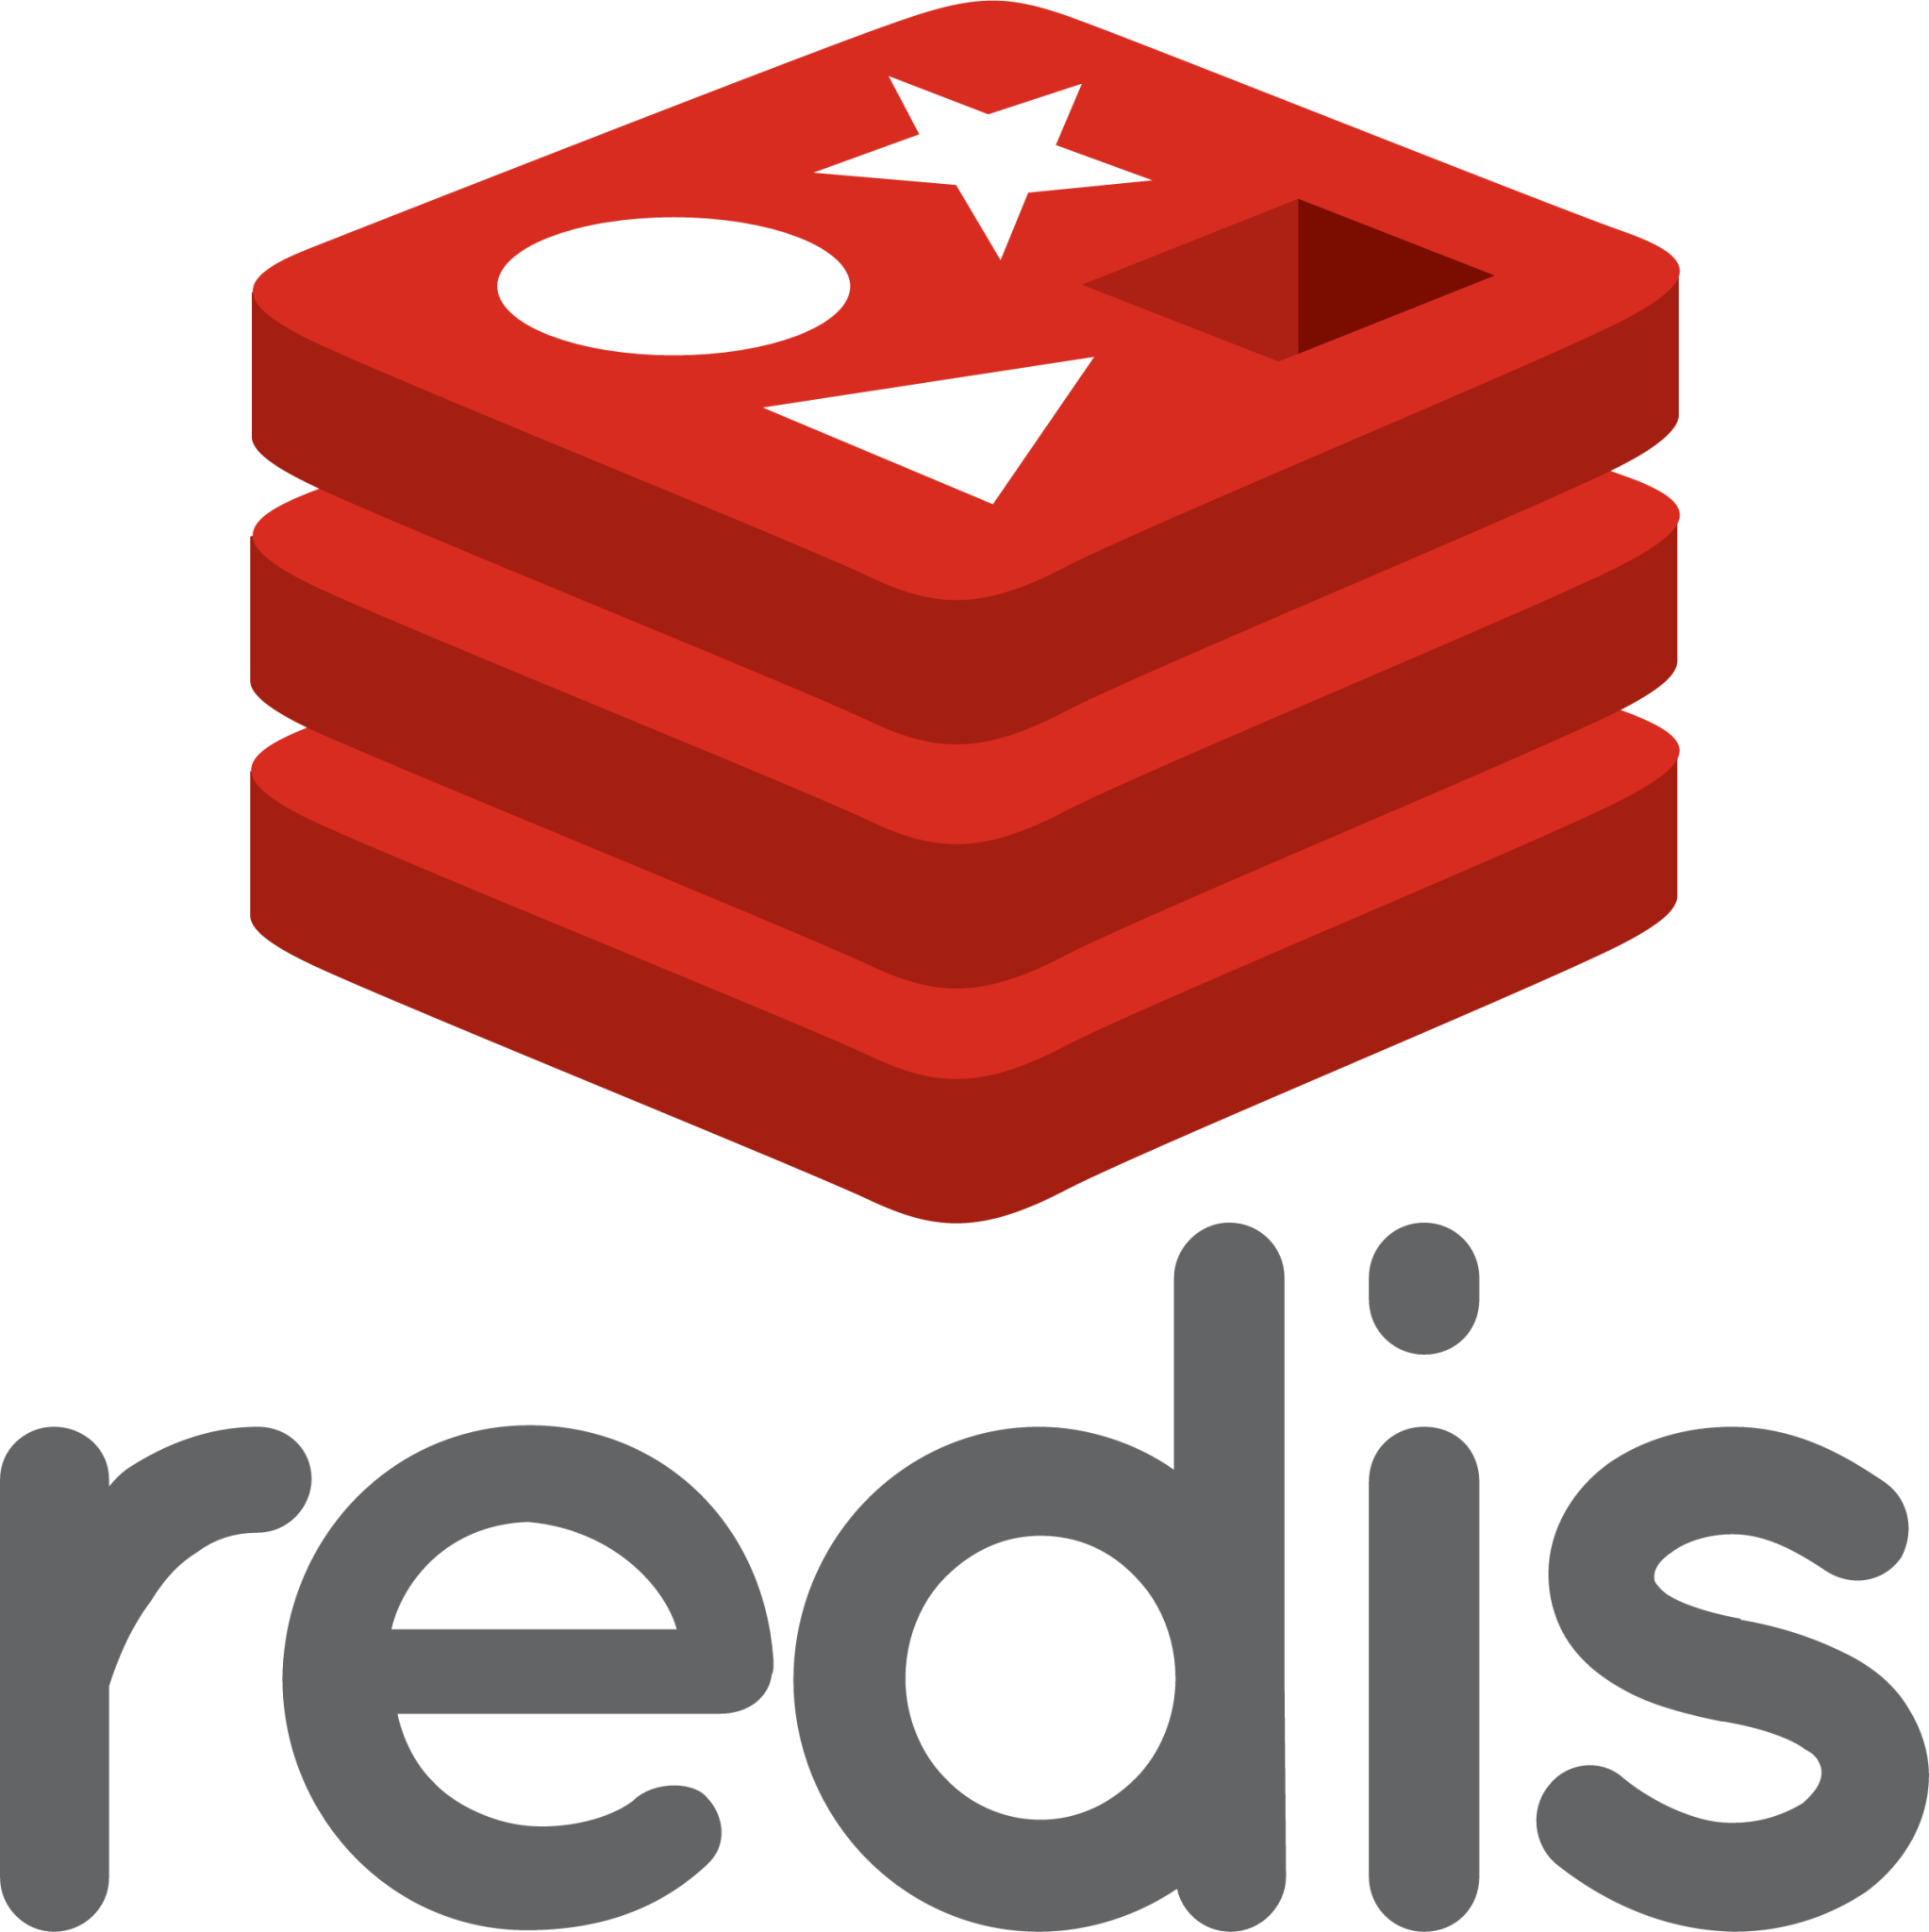


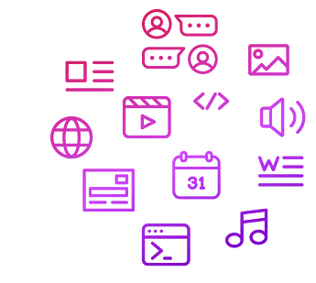
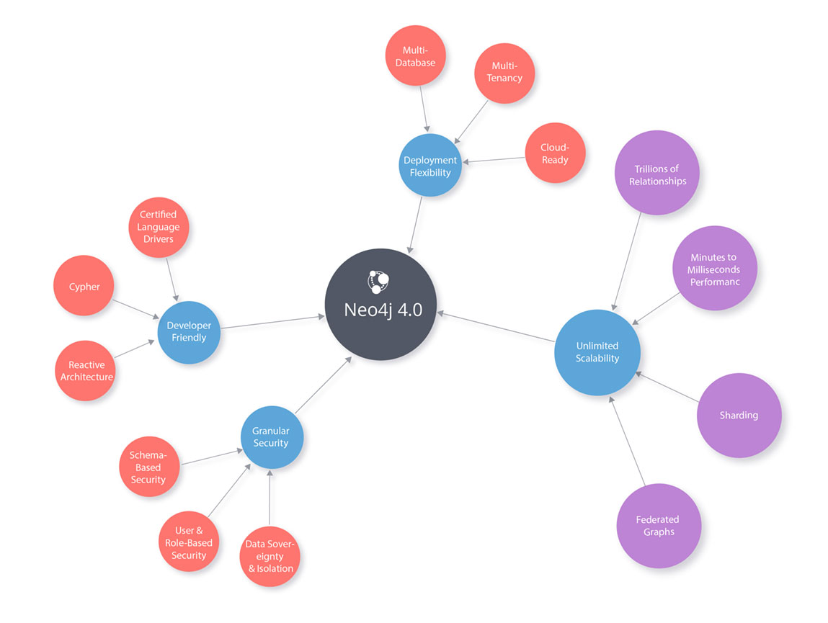
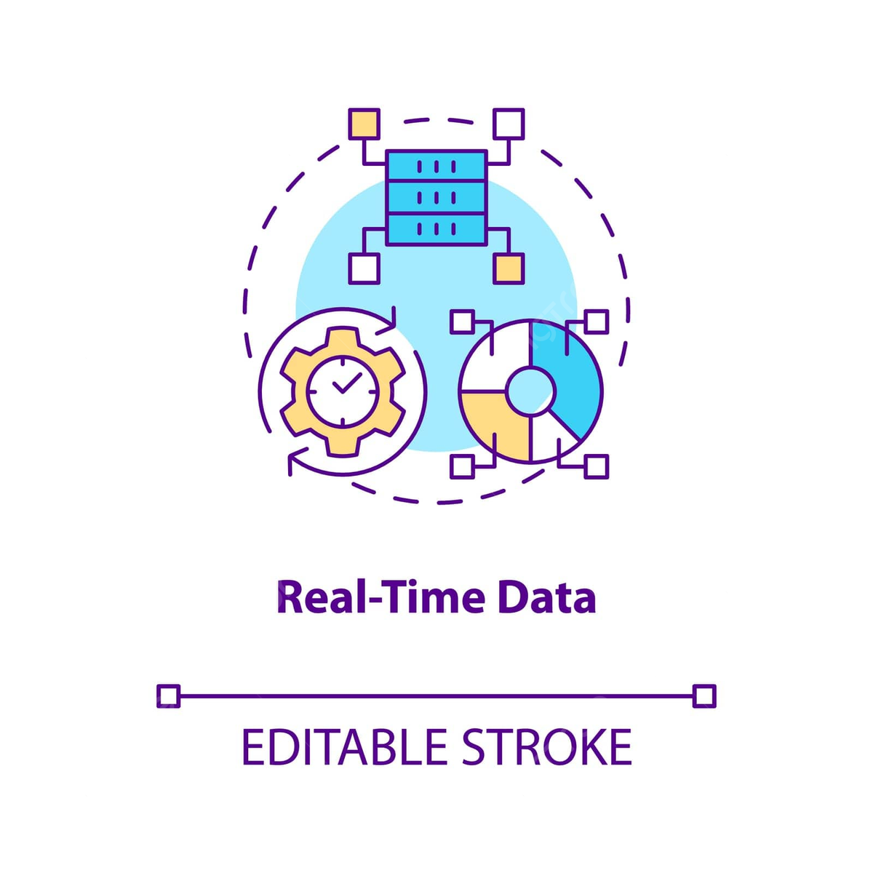
Going Beyond Tabular Data
Notes:
[David]
Today, we hope to bring a few additional tools to add to your team’s toolbox. Namely, they are Neo4J, MongoDB, and Redis. Neo4J is a great tool for leveraging graph-based connections and performing analytics on whole new sets of information that aren’t typically analyzed by data science professionals. MongoDB provides a cost-effective way to organize and store non-tabular data, such as customer documents or financial statements. Finally, Redis serves as a lightning-fast middleware for day-traders and brokers, think of it as a potential central nervous system between the markets and your bankers. These systems all have their advantages and tradeoffs, but if leveraged correctly, can help surface information in novel ways, without necessitating tabular data as an intermediary in each step.
In each of these examples, we hope to give a high level overview of how these systems work in the financial context. In the case for Neo4J, we provide a worked example within the portfolio diversification and risk management context.
The first tool I’d like to introduce to your team is Neo4J, a software used for organizing, visualizing and analyzing graph-theoretic relationships between any entities. The best way to communicate the value of this tool is through a business case example. Let’s suppose the business is interested in creating a portfolio of stocks that have adequate returns, but minimize global variability.

Slide 3

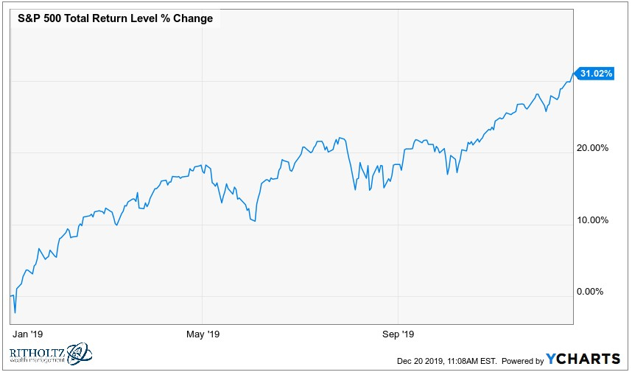
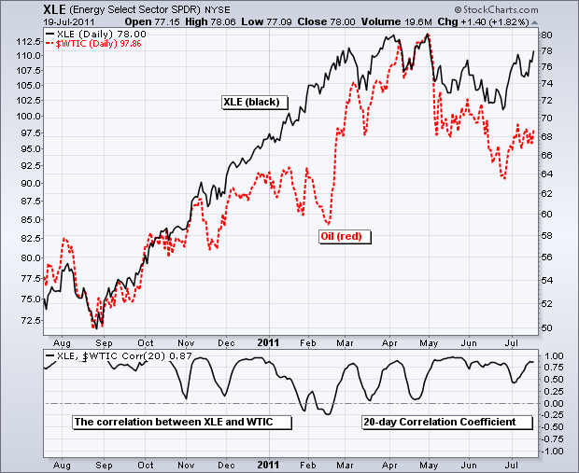
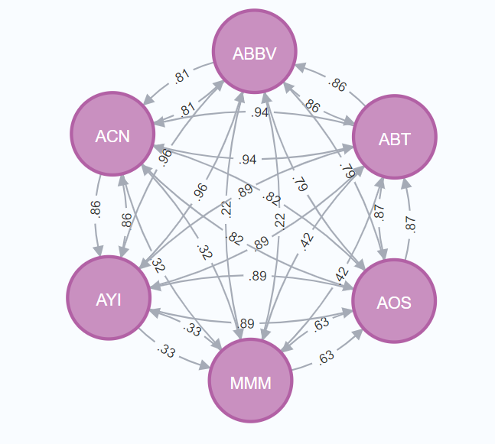
Portfolio Diversification with Neo4J
Notes:
[David]
We leverage Neo4J as a tool to illustrate diversity through historical data.
I’ll cover some of what your team would be already responsible for, in terms of tabular inputs & outputs, and then hand it off to my colleague Abhishek to show off some graph-theoretic algorithms that can be run in this type of task. He’ll also discuss some example conclusions we can generate for the business and banking teams.
As a preliminary disclaimer, this example is just an illustration of the technology, please do tune the parameters to whatever fits the business needs the most.
Nonetheless, in this analysis, we examine a subset of publicly traded securities in the S&P500. The criterion for our universe set are those securities who have been in the S&P500 list for at least the last six months. This totals about 430 different securities available for analysis. For each of these stocks, we use the Financial Modeling Prep API to fetch their daily closing prices over the last six months. Then, for each pair of two stocks, we determine the correlation between their last six month closing prices using the Pearson Correlation Coefficient and store that in tabular format. That information can finally be translated into a graph dataset with Neo4J, with 430 different nodes and 92665 edges.
The format we chose specifically was to have each node be a stock, and each edge be the correlation coefficient of the two. Since the bounds of each edge are between -1 and 1, we have natural lower and upper bounds that mimics distances between each node.
I’ll now hand it off to my colleague Abhishek to discuss a few ways these graphs can be analyzed for constructing diverse portfolios.

Slide 4
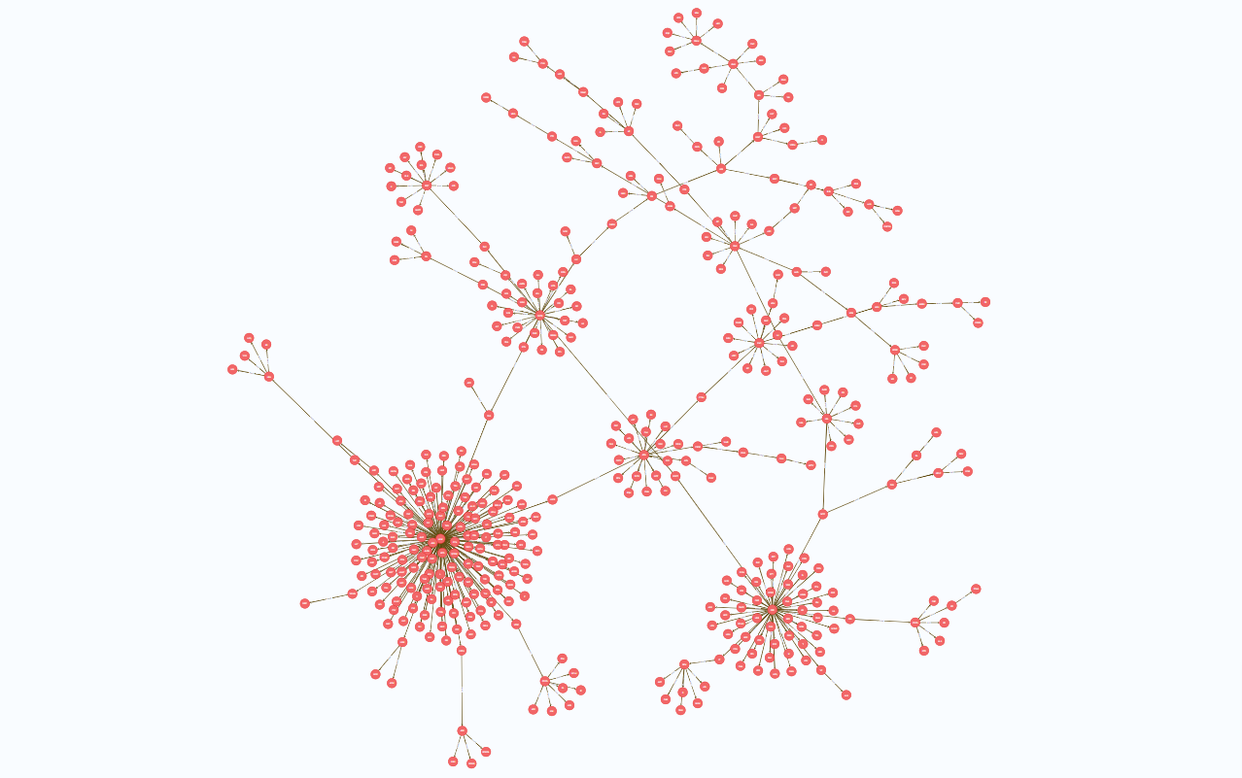
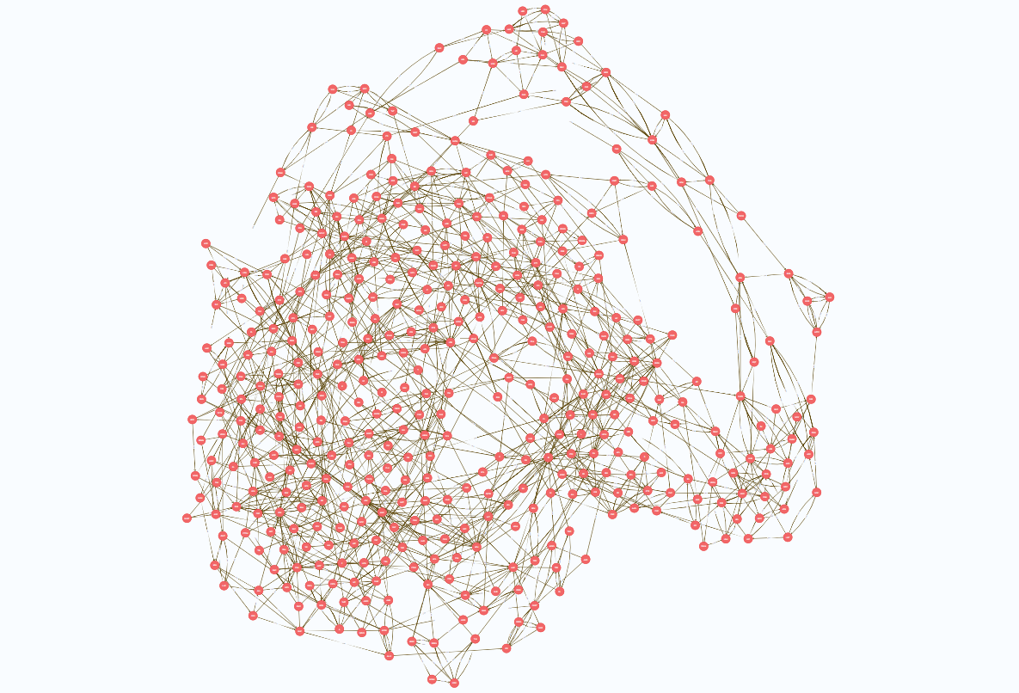
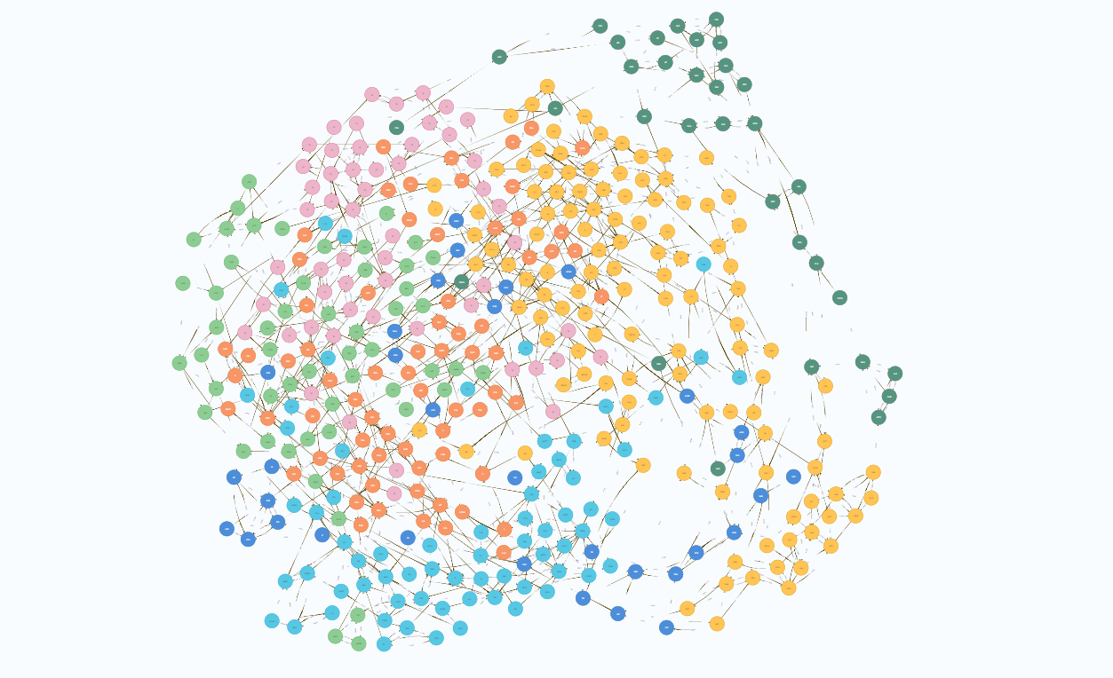
Our Graphing Algorithms
Minimum Spanning Tree
Degree Centrality
Louvain Modularity
Notes:
[Abhishek]
Thanks, David.
Let’s look at three Neo4j graph algorithms, Minimum Spanning Trees, Degree Centrality and Louvain Modularity.

Slide 5
Minimum Spanning Trees in Finance
Minimum spanning trees have been used for years in finance to study the correlation between stocks [Millington & Niranjan, 2020]
Sectors tend to be located in branches, though not always the case.
Stock MSTs tend to have central hubs.
Different analysts disagree over whether to “central” nodes or “peripheral” nodes form a more risk-averse portfolio.
Notes:
[Abhishek]
Minimum spanning trees, or the shortest path across all nodes, have a history of usage in the field of finance. Analysts use them to study correlations between stocks.
There are two options for an MST in finance - either use inverse of correlation or normal correlation coefficients. Using inverses will connect similar stocks, while using normal coefficients will connect dissimilar stocks.

Slide 6
Minimum Spanning Tree
Notes:
[Abhishek]
Here we use regular coefficients. In our tree, Neo4j seeks the shortest path by connecting nodes with low correlation coefficients. Our results are visible - you can see the hub and spoke structure of the graph. The hubs represent stocks that have very low correlation with several other stocks.

Slide 7
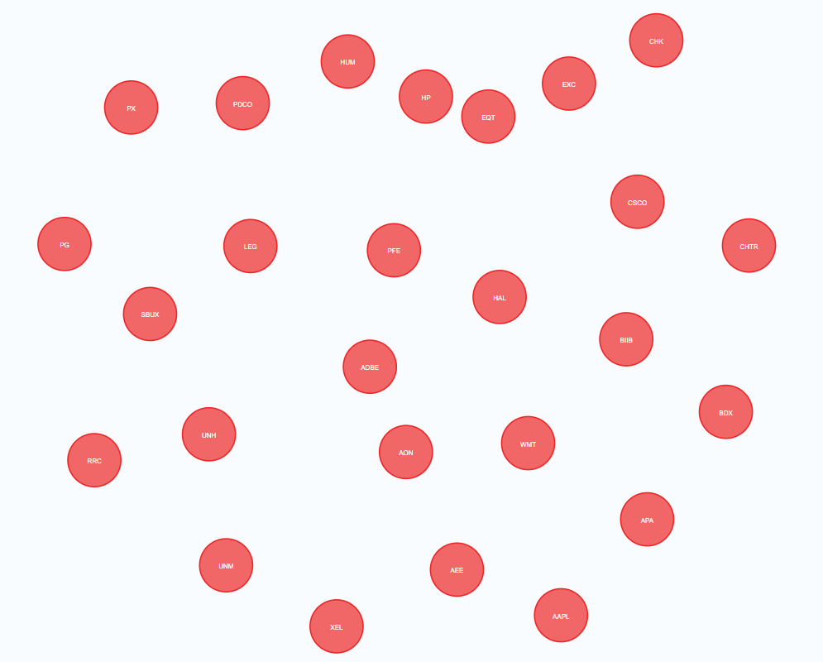
The Central Nodes
Notes:
[Abhishek]
Here we’ve selected out the central stocks that have the most connections in the tree, and we can pass over this kind of information to our analysts for further study.

Slide 8
Low Degree Centrality
To study only the most important correlations, we take each stock and retain only the relationships to its three most correlated stocks.
Stocks with low incoming degree centrality - or low number of incoming relationships - are those that don’t feature in other stocks’ three most correlated stocks.
Notes:
[Abhishek]
Another way to pick up low-correlation stocks is to use degree centrality - the number of connections a node has. For this, we modify our original graph. We go to each node, find the three highest correlation coefficient relationships and delete all other relationships. Our goal is to find stocks that don’t appear in other stocks’ three most correlated securities.

Slide 9
Low Degree Centrality
Notes:
[Abhishek]
Here’s the graph we get as a result, much sparser than our original graph. On this, we apply a degree centrality algorithm to find the stocks with the fewest remaining correlations…

Slide 10
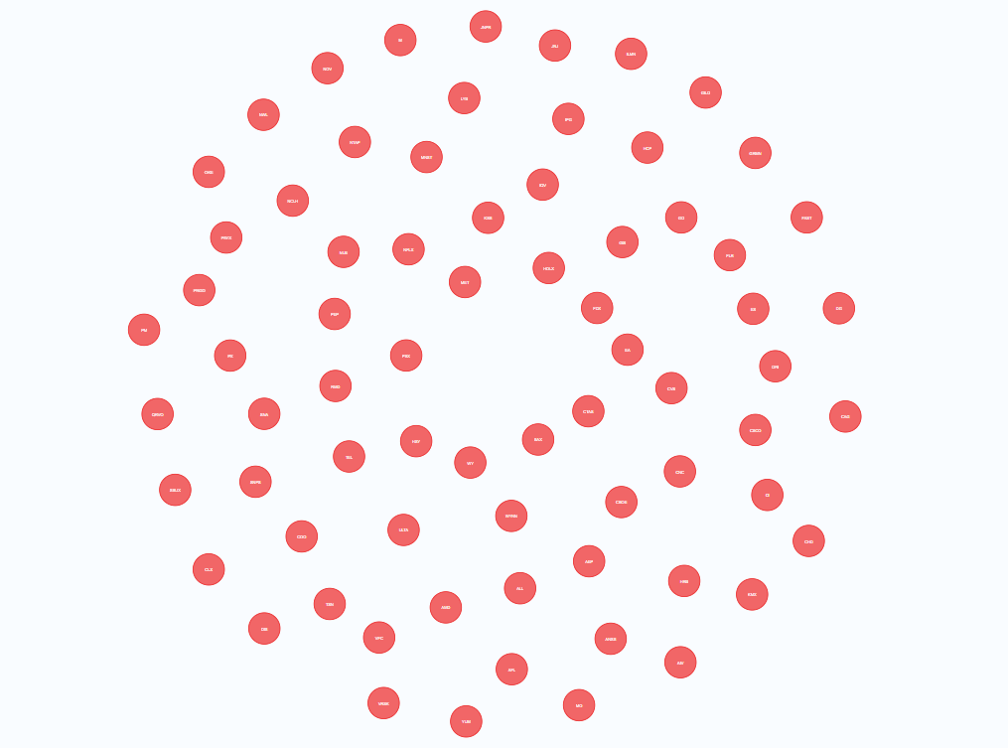
Low Degree Centrality Nodes
Notes:
[Abhishek]
And get this subset of stocks. They include Starbucks, Wynn Resorts and AMD.

Slide 11
Louvain Modularity Community Detection
The Louvain method is a method of community detection in graph networks to generate optimal modular communities based on the relationships between nodes.
Neo4j’s Louvain modularity algorithm is the probably the best at detecting communities, when compared to real-world communities (Drakopoulos, Gourgaris and Kanavos, 2019).
Notes:
[Abhishek]
Finally, we look at community detection as a way to get a balanced portfolio. Research has shown that within Neo4j community detection methods, Louvain modularity is the best at producing results that exists in real-world communities. This Louvain method optimizes for modularity - dense connections within communities, but sparse connections between different communities.

Slide 12
Louvain Modularity Communities
Notes:
[Abhishek]
Here we can see our communities, marked in different colors. You have large communities, like the gold one here, with 89 stocks and small ones with just three stocks. It’s worth noting that these stocks don’t quite match sectors.
Our bottom line here is Neo4j opens up possibilities that aren’t doable with SQL - this community detection would require significant time and code to generate in SQL. With Neo4j, we can efficiently analyze stock market links, discovering hidden connections you wouldn’t discover if you just looked at sectors.
Over to my colleagues Justin and Zeynep to tell us more about the power of NoSQL database solutions.

Slide 13






Customer Account Dashboards Backed by Redis
Client 1 Session
Client 2 Session
Customer Dashboard Architecture
Client signs-in to containerized application with web-based dashboard
Each client session has a Redis instance that pulls live price data through web-APIs and integrates live prices with up-to-date account information and portfolio holdings.
Portfolio valuations and other risk metrics are calculated immediately and stored in Redis at position level (by asset). Users can also set alerts and notifications that will update immediately.
Dashboard will provide live updates of valuations and analytics, giving clients the ability to make timely investing decisions
Data Example
“Asset ID”:AAPL
{
“Quantity”:1000
“Current Price”:200.00
“Base Price”:150.00
“Value”:200000
“Profit”:50000
“Time”:15:59
}
Notes:
https://redis.com/blog/real-time-trading-platform-with-redis-enterprise/
include in repo:
slides, code, have ready to run notebook
do a dry run
remember self evaluations
feedback form for other teams

Slide 14
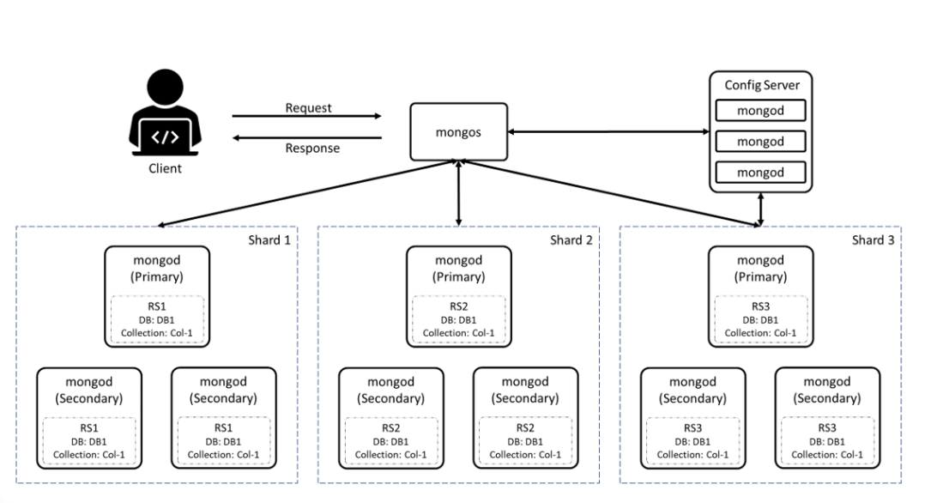
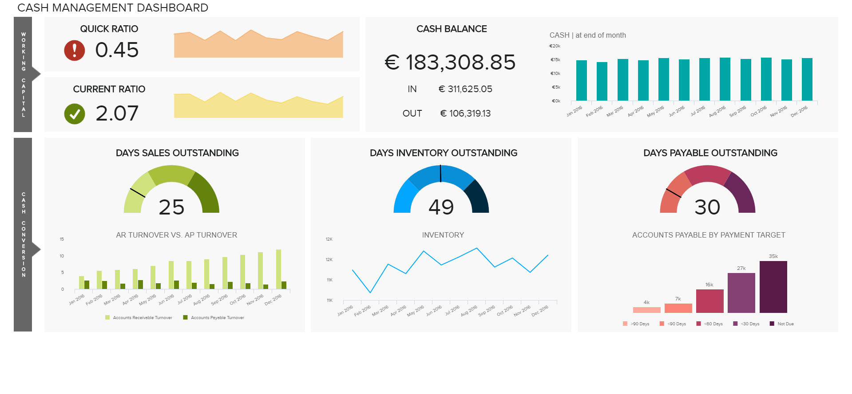
Customer Account Dashboards Enhanced by MongoDB
Dashboard Architecture
Web-Based Containerized Application
Authentication Service
API Gateway
Microservices:
Price Data Service,
Portfolio Service,
Alerts and Notifications Service
MongoDB Database:
Collections:
Price Data Collection
Portfolio Collection
Dashboard UI
Data Example
{
"_id": ObjectId("609c85a065b9e7baf6b0a261")
"client_id": "123456",
"asset": "AAPL",
"quantity": 100,
"cost_basis": 145.75
}

Slide 15

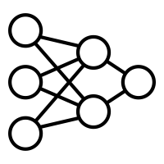

Managed Account Trading Strategies with Redis
Futures
Trader
Forex
Trader
Trading
Bot
Data Example
Ticker: “AAPL”
{
“Bid Price”:168.52
“Bid Size”:400
“Ask Price”:168.60
“Ask Size”:200
“Time”:15:59
}
Trading System Architecture
Live price data is sent directly from exchanges to Redis through APIs.
Redis feeds data to online machine learning models to quickly generate trading signals.
Trading signals are stored in a queue and sent to traders (for mid-frequency trading) or automated trading programs (for high-frequency trading).
Price and signal data are sent to MongoDB long-term storage so analysts and managers can evaluate models and develop new strategies.
*Financial data companies such as Bloomberg and Factset offer APIs with historical security “tick” data (data on every value change), but there might be an opportunity for cost savings by storing daily Redis data instead.
Notes:
https://redis.com/blog/real-time-trading-platform-with-redis-enterprise/
Trade/valuation alerts for fully managed accounts
Explore opportunites to use redis to gather “tick” data from exchanges
Bloomberg/Factset/others already provide this service (?)
Cost Savings
Questions for office hours
– is this how a redis queue would be used, or is it meaningless to have this there?

Slide 16
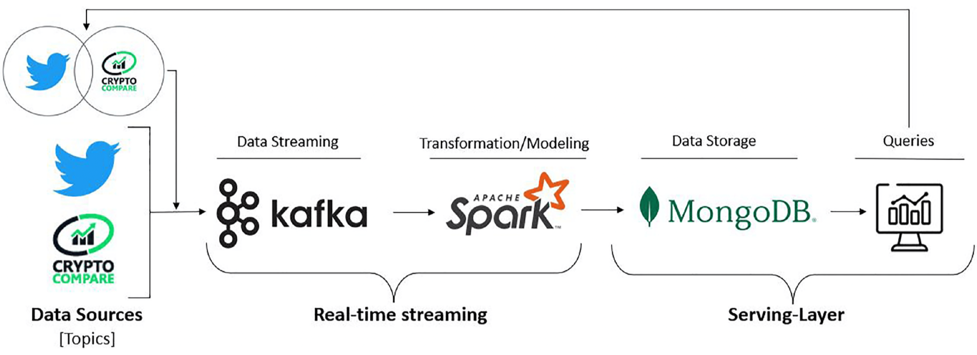

A trading system architecture using MongoDB for storing both live price data and trading signals
A trading system architecture using MongoDB
Data Ingestion and Storage:
Machine Learning Model Integration:
Trading Execution:
Long-Term Storage and Analysis:
Integration with Third-Party Data Providers:
Data Example
{
"_id": ObjectId("609c85a065b9e7baf6b0a25f"),
"symbol": "AAPL",
"name": "Apple Inc.",
"price": 150.25,
"timestamp": ISODate("2024-04-14T08:30:00Z")
}

Slide 17
Conclusion
Financial services companies need to continually update their tech stack to compete in the industry and.
Graphing algorithms are a unique and exciting new way to construct diversified portfolios.
Using a combination of Redis and MongoDB, companies can provide clients with timely information and analytics.
These methods would help many financial institutions improve the services they offer to customers.

